Slide 1


2021 Customer Insights
Bike Co. XYZ
Bike co. xyz
This presentation is designed to be viewed using the Slide Show feature
-Click the Slide Show tab above, then click “Play from Start” and the presentation will play by itself

Slide 2
Project Overview & Relevant Information
Project Objective
Create an insightful dashboard from customer data to assist in performing basic exploratory data analysis
Goals
Identify key customer demographics of interest
Identify any significant changes in bike sales based on region and various fields of interest (i.e. customer commute and age bracket)
Dataset Used
Fictitious dataset on bike sales created by YouTuber Alex the Analyst
Data Cleaning Process
Utilized column filter to check for any missing values
Removed duplicate customer ID rows
Searched for and replaced F’s with Female and M’s with Male in the Gender
column to provide more context to the data
Searched for and replaced S’s with Single and M’s with Married in the Marital
Status column to provide more context to the data
Created Age Bracket column to provide better insights regarding customer age
Dashboard Creation
Created pivot tables with relevant fields and utilized these to create pivot charts
Added all relevant pivot charts onto dashboard and utilized slicers to filter on fields of interest
Fields Used in Analysis
Customer ID Number
Marital Status
Gender
Income
Number of Children
Education Level
Occupation
Home Owner Status
Number of Cars Owned
Commute Distance
Region
Age
Age Bracket (created for analysis)

Slide 3
Customer Demographics
Customer Age Insights:
Middle-aged customers (31-54 years old) make up the largest portion of customer responses
(710/71% of customer responses)
Middle-aged customers also have the highest percentage of customers who bought bikes
(54% of Middle-aged customers bought bikes)

Slide 4
Customer Demographics (continued)
Gender and Marital Status Insights:
There is an even split of male and female customer responses, with roughly equal purchasing behavior between the 2 genders
(49% females and 47% males bought bikes)
There are slightly more married than single customers who responded (54% married), however, it appears a larger portion of single customers purchased bikes
(54% singles vs 43% married customers bought bikes)

Slide 5
Customer Demographics (continued)
Region & Occupation Insights:
North America has the largest portion of customer responses
508/51% customer responses
The Pacific region has the largest percentage of customers who bought a bike
59% of customers from the Pacific region bought a bike
Customers who are Professionals or are in Skilled Manual Labor make up the largest portion of customers
53% of all customers combined
Customers who are Professionals have the highest percentage of bikes bought
54% of Professionals bought a bike

Slide 6
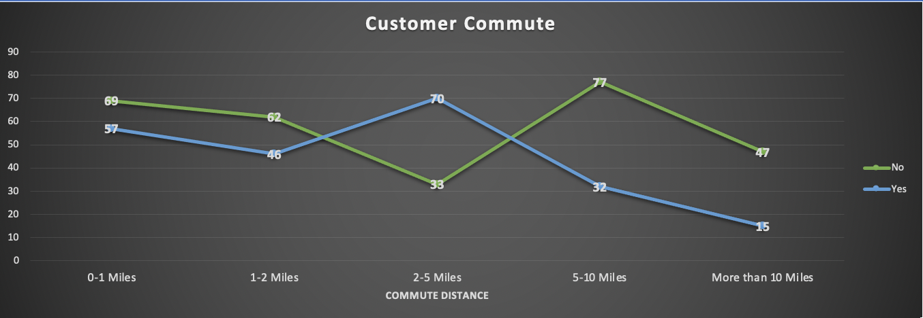
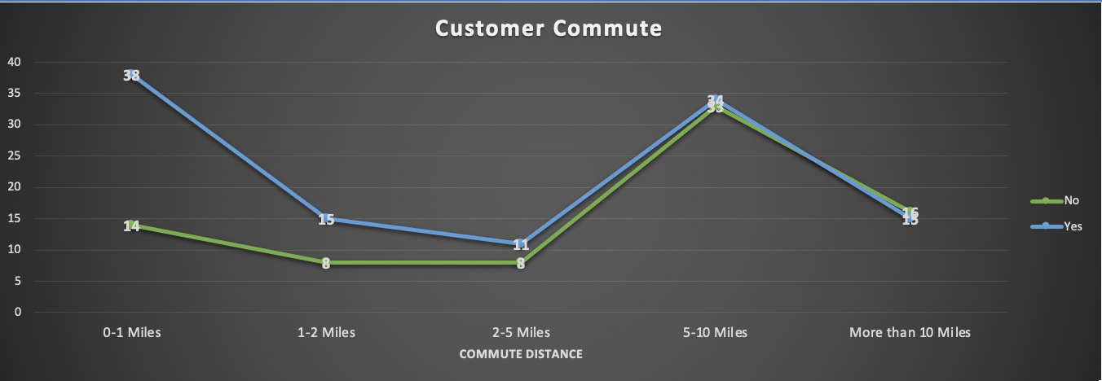
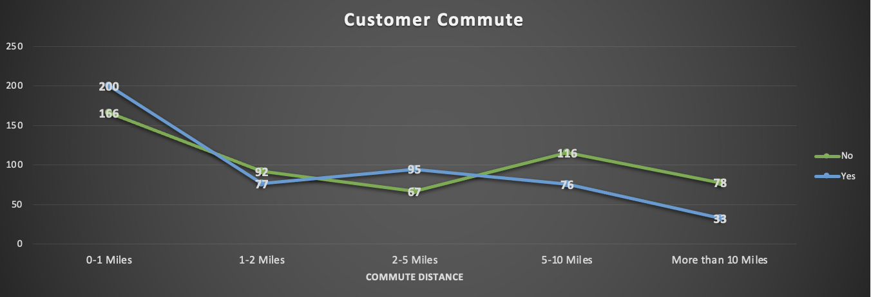
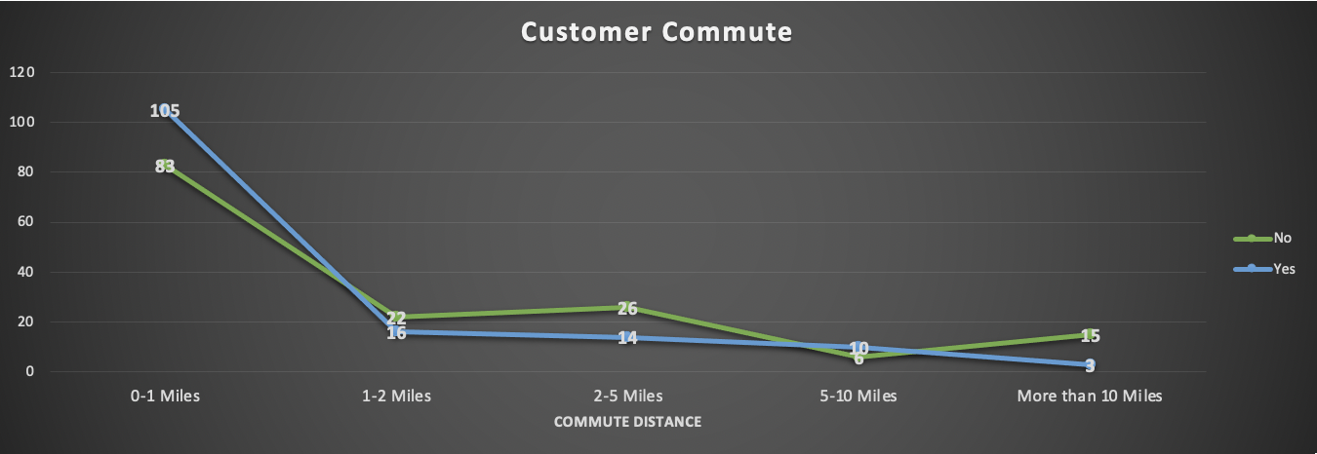
Sales Based On Customer Commute
BY REGION
OVERALL
Europe
Pacific
North America
73% of customers in the Pacific with a commute
of 0-1 miles bought a bike
42% of customers who bought a bike
had a commute of 0-1 miles
68% of customers in North America with a
commute between 2-5 miles bought a bike
71% of customers who bought bikes in Europe had
a commute of 0-1 miles
59% of customers with a commute
of 2-5 miles bought a bike
65% of customers in the Pacific with a commute
of 1-2 miles bought a bike

Slide 7
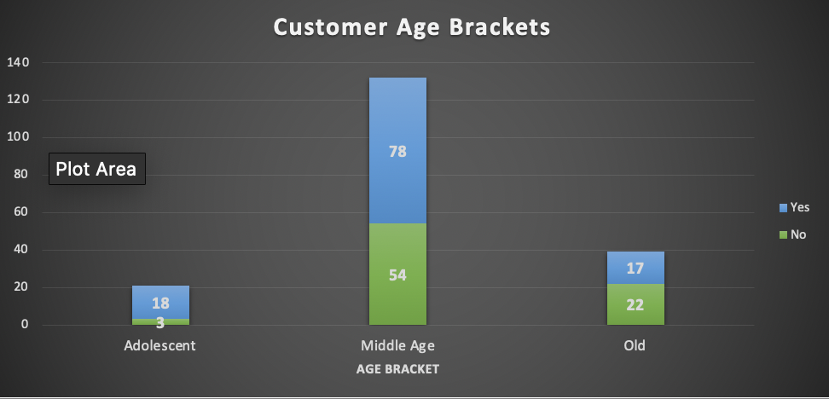

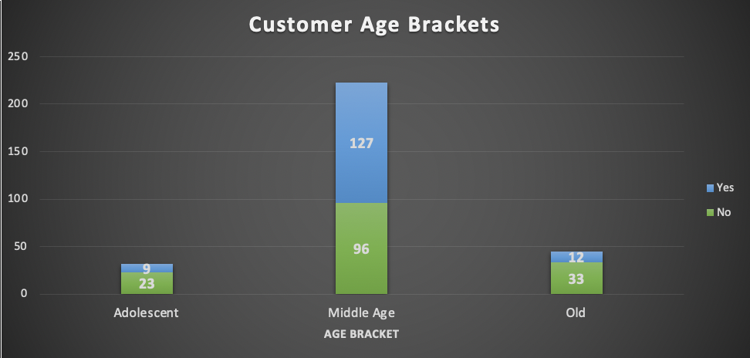
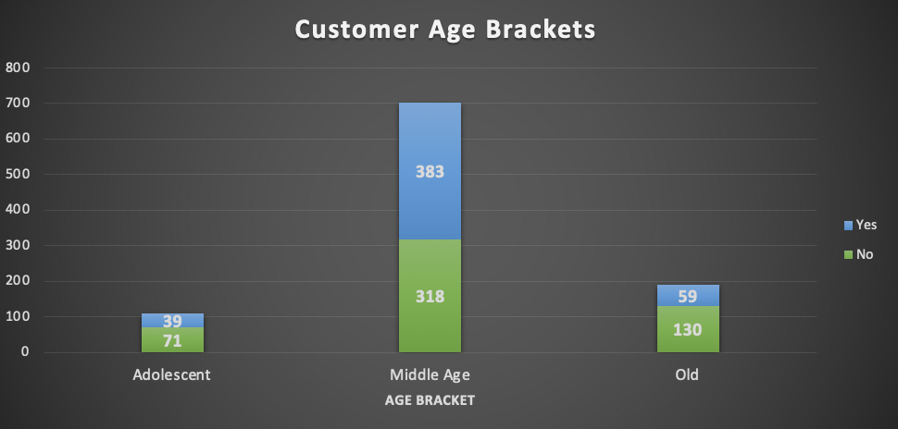
Sales Based on Customer Age Bracket
BY REGION:
OVERALL
North America
Europe
Pacific
59% of customers in the Pacific who
are Middle-Aged bought a bike
57% of European customers who are
Middle-Aged bought bikes
55% of customers who are
Middle-Aged bought bikes
51% of North American customers who
are Middle-Aged bought bikes
86% of customers in the Pacific who
are Adolescents bought a bike

Slide 8
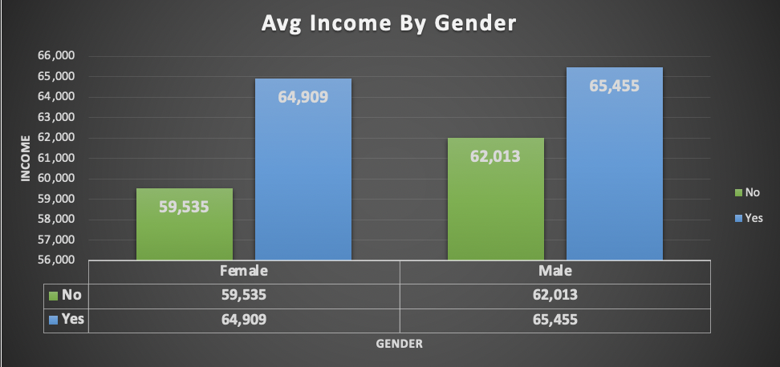
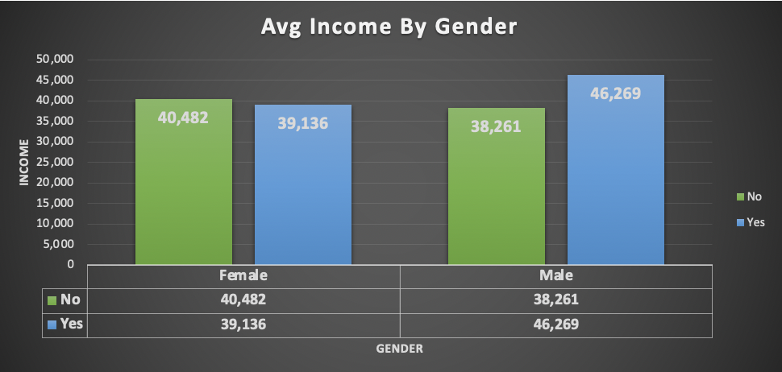
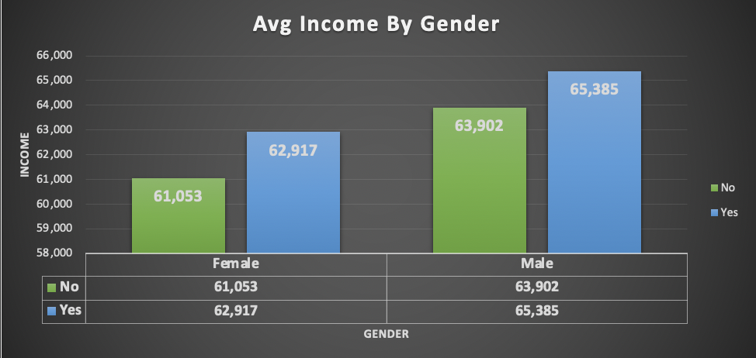
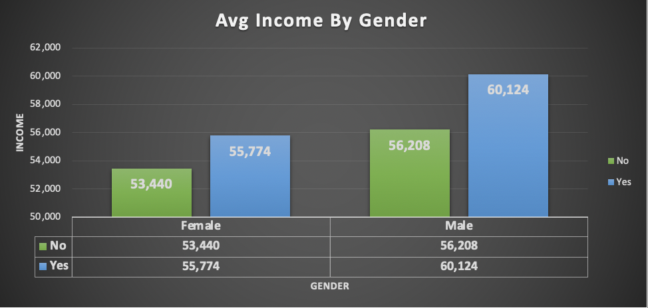
Average Customer Income
REGION
Pacific
Europe
North America
OVERALL
$5K more than
overall average
$5K more than
overall average
$13.8K less than
overall average
$9K more than
overall average
$7K more than
the overall average
$16.6K less than
overall average

Slide 9
Summary of Insights
Middle-aged customers (32-54) are the largest portion of Bike Co. XYZ’s customers and have the highest percentage of bikes bought out of any age group
Customers who identify as single have a higher percentage of bikes bought than those who identify as married (54% vs 43% respectively)
Customers in the Pacific region have the highest percentage of bikes bought out of any region (59%)
Customers with work commutes of roughly 0-1 miles or 2-5 miles tend to have the highest percentage of bikes bought, especially in the Pacific region
North American customers have the highest average income out of any region, with males having higher incomes than females across all regions

Slide 10
Suggestions Moving Forward
Advertisements should look to target customers within the Middle-Age bracket (31-54), ensuring to use appropriate forms of media that appeal to this age group
Larger portions of customers who buy bikes from Bike Co. XYZ have short work commutes, which may imply that customers use the company’s bike as a form of transportation to work
Product development may wish to research potential bike attachments/features that appeal to the needs of customers traveling to and from work
Although the Pacific region is the smallest region (19% of customers), it is the region with the highest percentage of customers who buy bikes (59%)
May look to increase marketing efforts within the region to increase the number of people aware of Bike Co. XYZ’s bikes

